Slide 1
Cowork Super User
Interpretation Guide
A consultant’s page-by-page guide to reading adoption, concentration, trends, value assumptions, and share movement.
DEMO DATA
Screenshots captured from the PBIX using fully synthetic data.
Source report: Cowork Super User V1 PBIX.pbix | Created October 2026

Slide 2
The three numbers that matter
2
Start every executive conversation here.
REACH
INTENSITY
VALUE
219 active users
170K credits / user / month
6.09× value / credit cost
How broadly Cowork is being used.
How deeply users consume the service.
Modeled value relative to attributable credit cost.
Consultant storyline
Reach establishes scale. Intensity reveals concentration and operating behavior. Modeled value tests whether selected assumptions make the consumption economically meaningful.
These figures are from the synthetic demo state and will change with filters and assumptions.

Slide 3
How to use this guide
3
Move from evidence to interpretation to action.
1
Observe
Read the page headline, period comparison, filters, and dominant visual pattern.
2
Interpret
Explain the business mechanism: breadth, intensity, task mix, price, or time assumption.
3
Challenge
Test alternative groupings, periods, departments, and assumptions before drawing conclusions.
4
Act
Translate the pattern into an enablement, governance, validation, or measurement action.
Important: modeled value is directional—not guaranteed realized savings. Validate assumptions with customer stakeholders.

Slide 4
The consultant’s reading order
4
Build the story from scale to economics, then validate the definitions.
1
Overview
2
Cost Concentration
Establish reach, activity, and task-type mix.
Find high-intensity cohorts and behaviors.
3
Trends
4
Group Breakdown
Separate volume growth from credits-per-task movement.
Diagnose when and what drove cohort spend.
5
Share Shift
6
Category Assumptions
See which cohorts and departments are gaining influence.
Validate the time-saved inputs.
7
Value Assumptions
8
Metric Glossary
Translate usage into directional economics.
Confirm definitions, sources, and caveats.

Slide 5
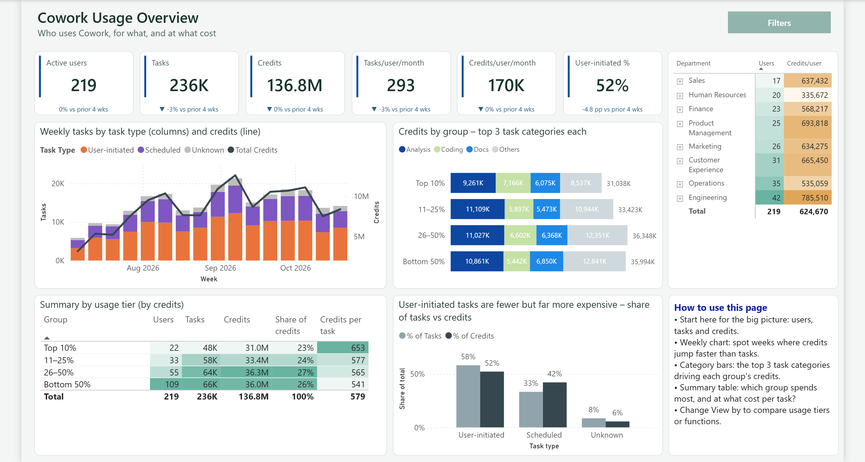
1. Cowork Usage Overview
5
Who uses Cowork, for what, and at what cost.
KEY BUSINESS QUESTION
Is adoption broad, sustained, and economically understandable?
HOW TO READ IT
• Read KPI cards first; then compare weekly tasks with credits.
• Use tier and department tables to test concentration.
CONSULTANT ACTION
• Confirm whether growth is broad or driven by a few users.
• Choose the next drill-down: concentration or task mix.
WATCH-OUT
Credits are consumption, not business value. Do not equate higher credits with better outcomes.

Slide 6
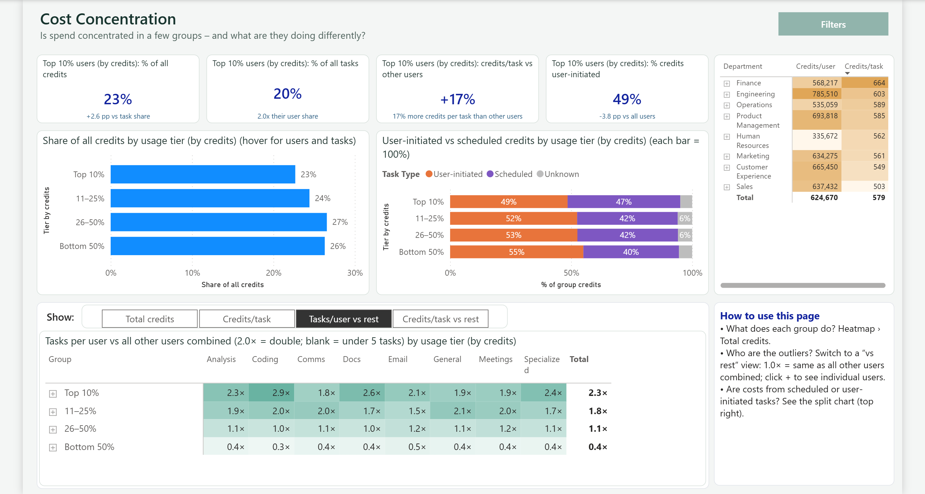
2. Cost Concentration
6
Where spend is concentrated—and what high-usage cohorts do differently.
KEY BUSINESS QUESTION
Do the highest-usage users consume more because they do more tasks or because each task costs more?
HOW TO READ IT
• Compare credit share with task share.
• Use “vs rest” heatmaps to isolate category outliers.
CONSULTANT ACTION
• Interview high-intensity cohorts for repeatable practices.
• Flag unusual credits/task patterns for governance review.
WATCH-OUT
Tier labels rank users by credits; they are descriptive cohorts, not performance ratings.

Slide 7
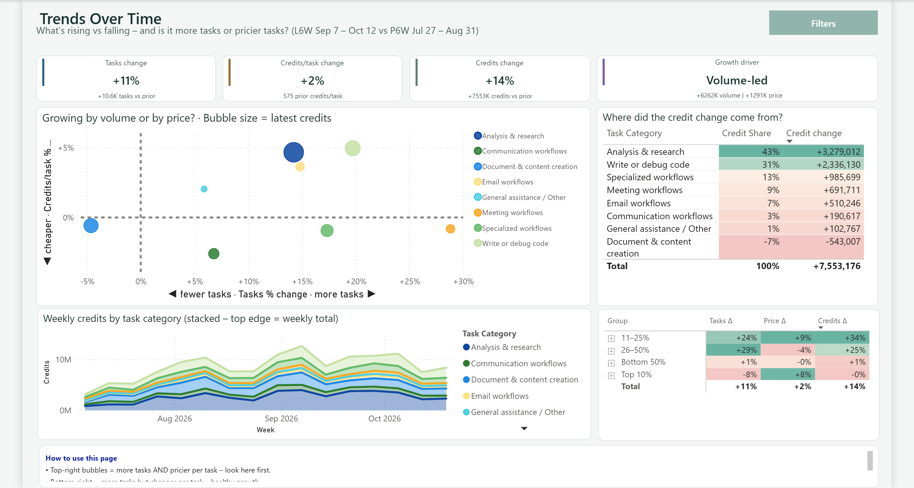
3. Trends Over Time
7
Distinguish volume-led growth from price or task-complexity movement.
KEY BUSINESS QUESTION
What changed—and was it more tasks, more credits per task, or both?
HOW TO READ IT
• Start with the three change cards and growth driver.
• Use bubble quadrants and the contribution table to identify causes.
CONSULTANT ACTION
• Investigate categories in the upper-right quadrant first.
• Connect spikes to launches, campaigns, or workflow changes.
WATCH-OUT
A higher credits/task ratio can reflect complexity or inefficiency; the report alone cannot decide which.

Slide 8
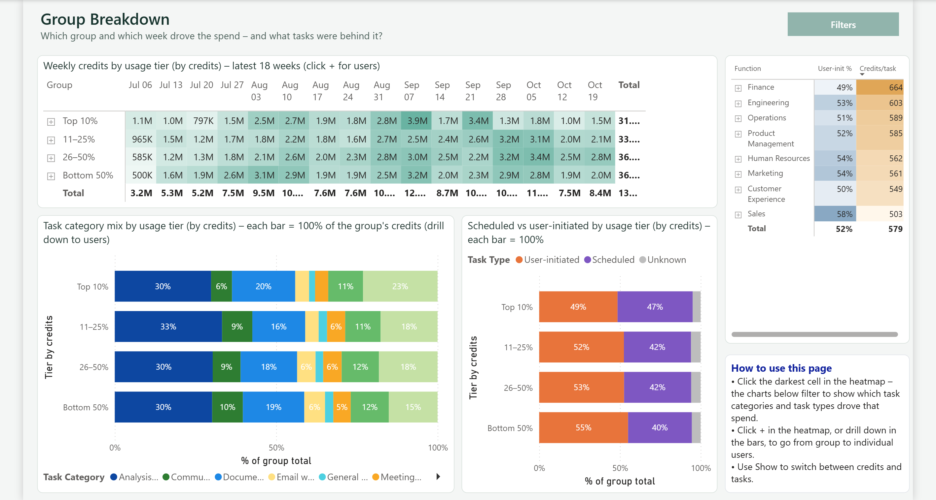
4. Group Breakdown
8
Diagnose the weeks, categories, and task types behind cohort consumption.
KEY BUSINESS QUESTION
Which cohort drove the spend, when did it happen, and what work was behind it?
HOW TO READ IT
• Click heatmap peaks, then read category and task-type mix.
• Drill from tiers to users only when a specific pattern warrants it.
CONSULTANT ACTION
• Turn recurring high-value patterns into enablement examples.
• Escalate anomalous scheduled-task concentrations for review.
WATCH-OUT
Avoid presenting individual-user drill-downs as employee evaluation.

Slide 9
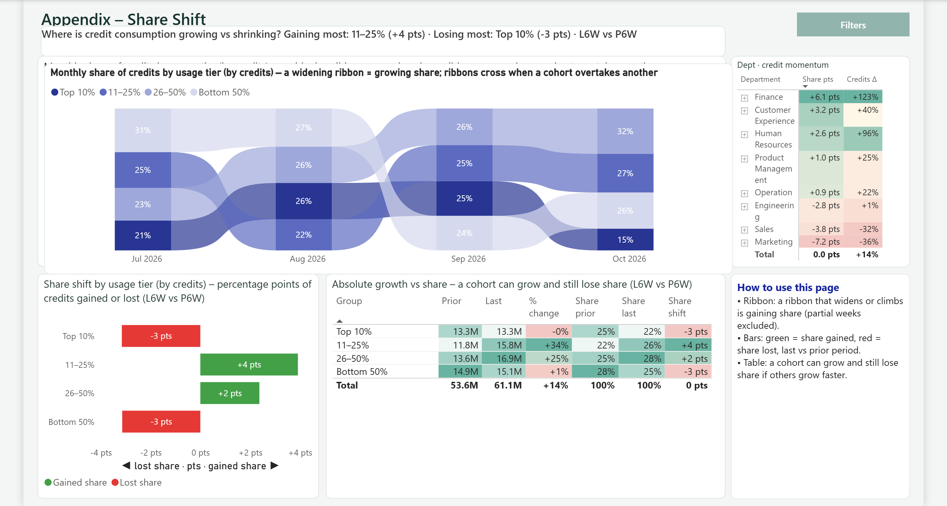
5. Appendix – Share Shift
9
See who is gaining or losing share of total credit consumption.
KEY BUSINESS QUESTION
Which cohorts or departments are becoming more influential—even if total usage also grows?
HOW TO READ IT
• Ribbon crossings show cohort overtakes over time.
• Separate absolute growth from percentage-point share movement.
CONSULTANT ACTION
• Target enablement where share and absolute credits rise together.
• Investigate share loss before assuming adoption failure.
WATCH-OUT
Share can fall while credits rise if other cohorts grow faster.

Slide 10
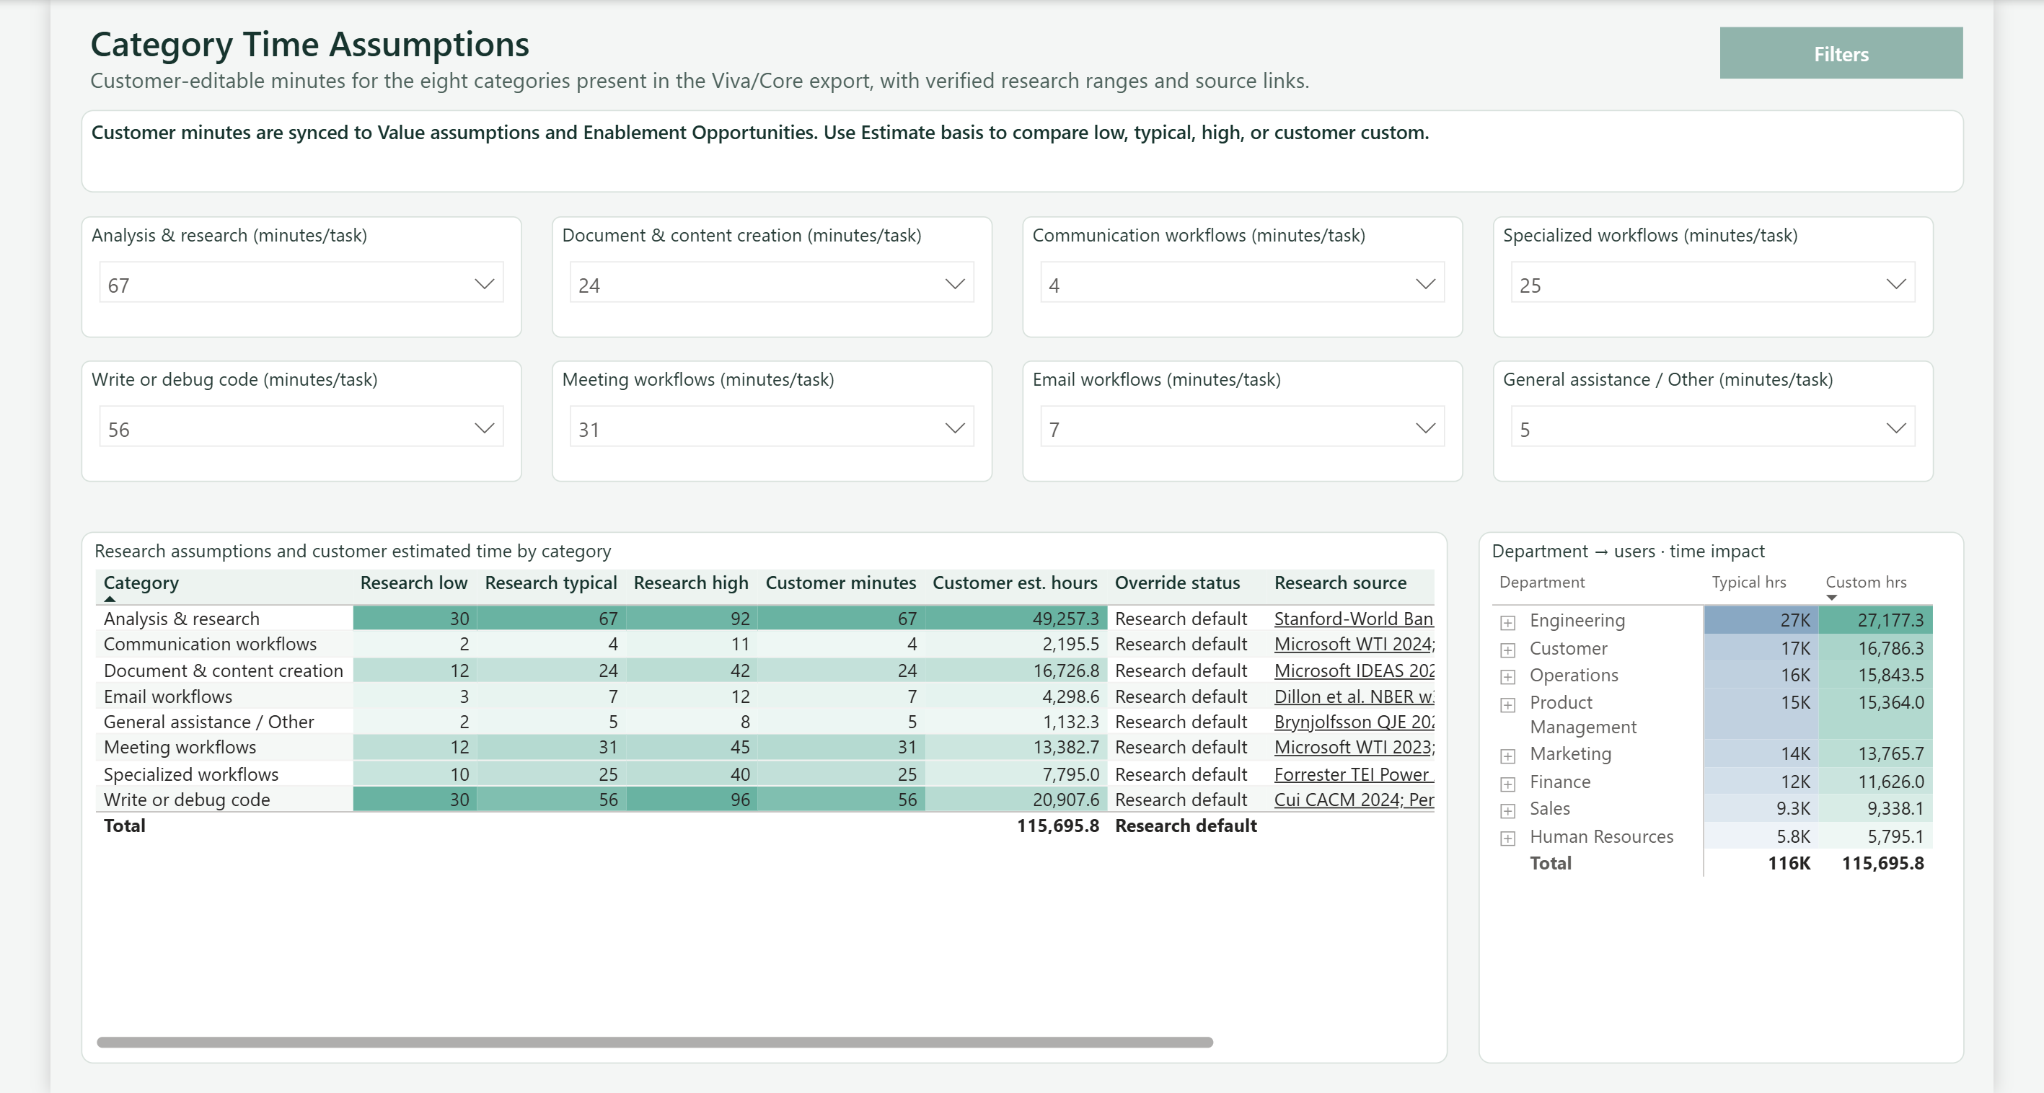
6. Category Time Assumptions
10
Validate the minutes-saved assumptions that drive modeled value.
KEY BUSINESS QUESTION
Are the selected minutes per task credible for this customer and use case?
HOW TO READ IT
• Compare customer minutes with research low/typical/high.
• Review department-level hours for scale implications.
CONSULTANT ACTION
• Run a stakeholder calibration workshop.
• Document overrides and evidence before executive use.
WATCH-OUT
Research ranges are starting points; customer validation is required.

Slide 11
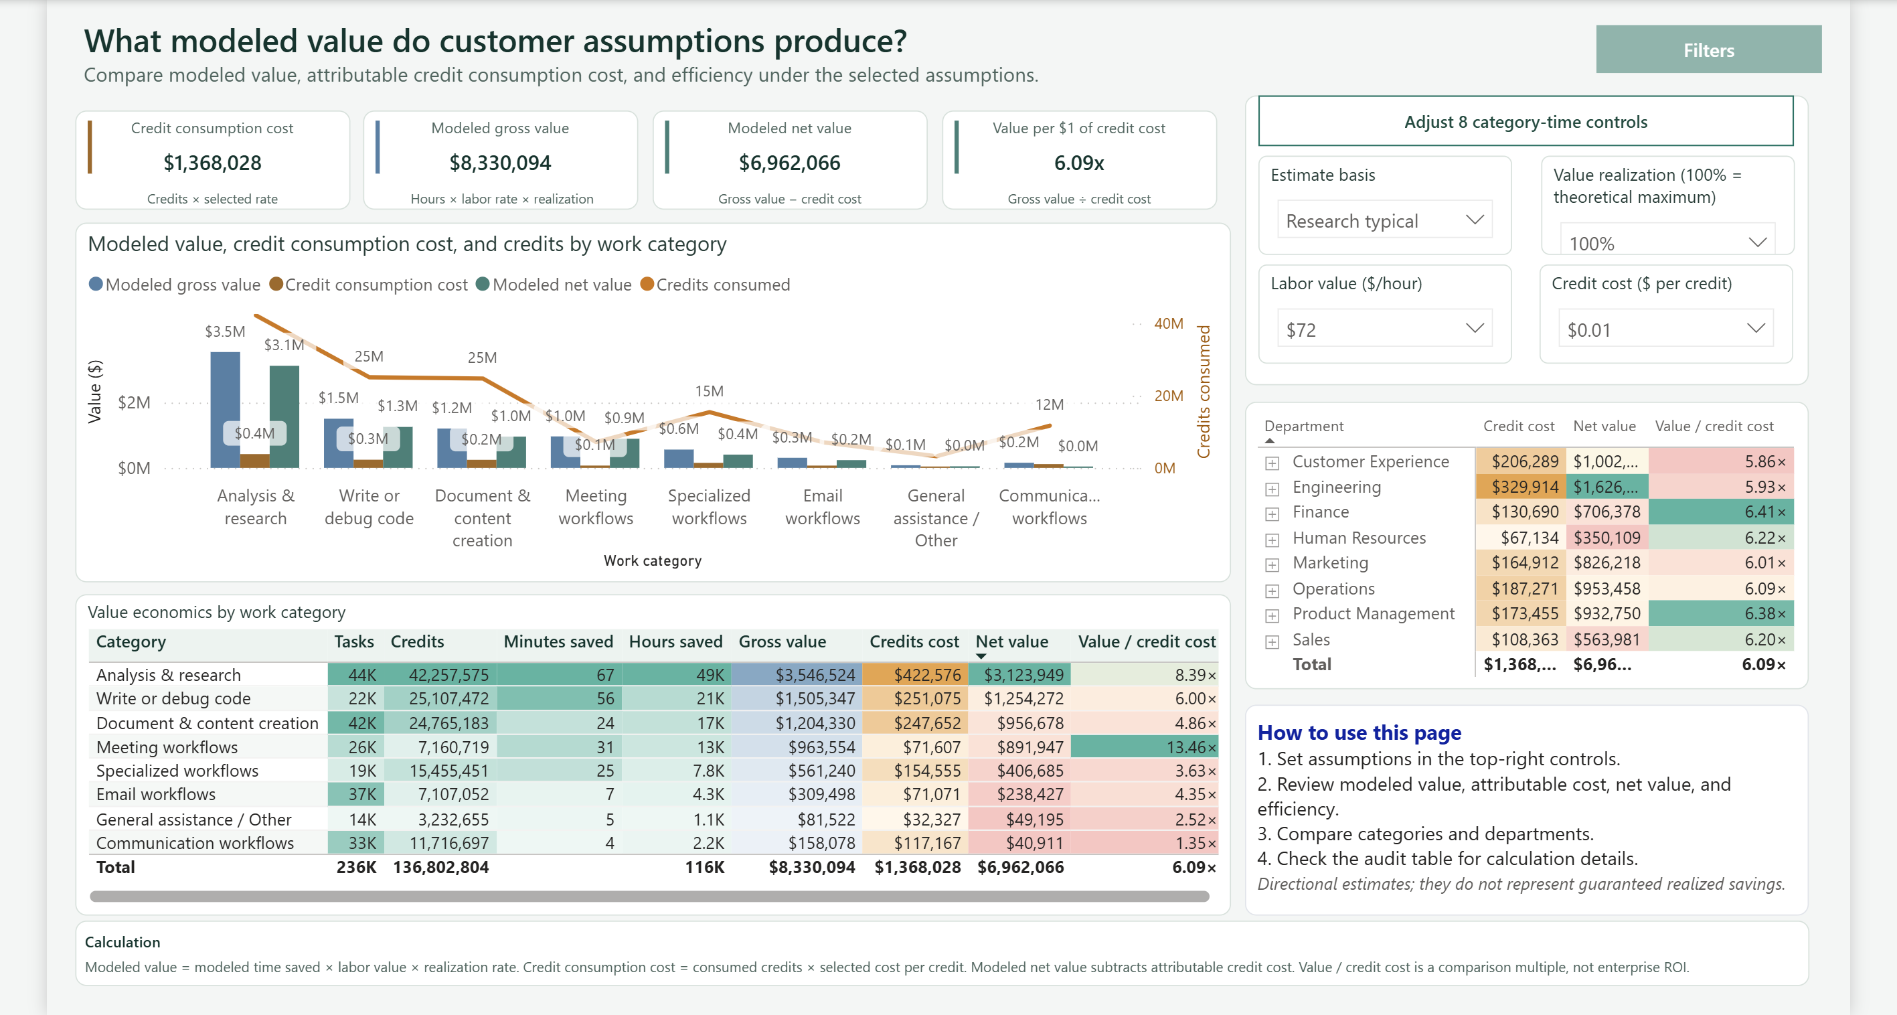
7. Value Assumptions
11
Translate observed activity into directional economics.
KEY BUSINESS QUESTION
Under the selected assumptions, where is modeled value strongest and most sensitive?
HOW TO READ IT
• Set estimate basis, realization, labor value, and credit rate.
• Compare category and department economics, then audit the calculation table.
CONSULTANT ACTION
• Present a low/typical/high sensitivity range.
• Use the model to prioritize validation—not to claim realized savings.
WATCH-OUT
Value per credit cost is a scenario multiple, not enterprise ROI or booked savings.

Slide 12
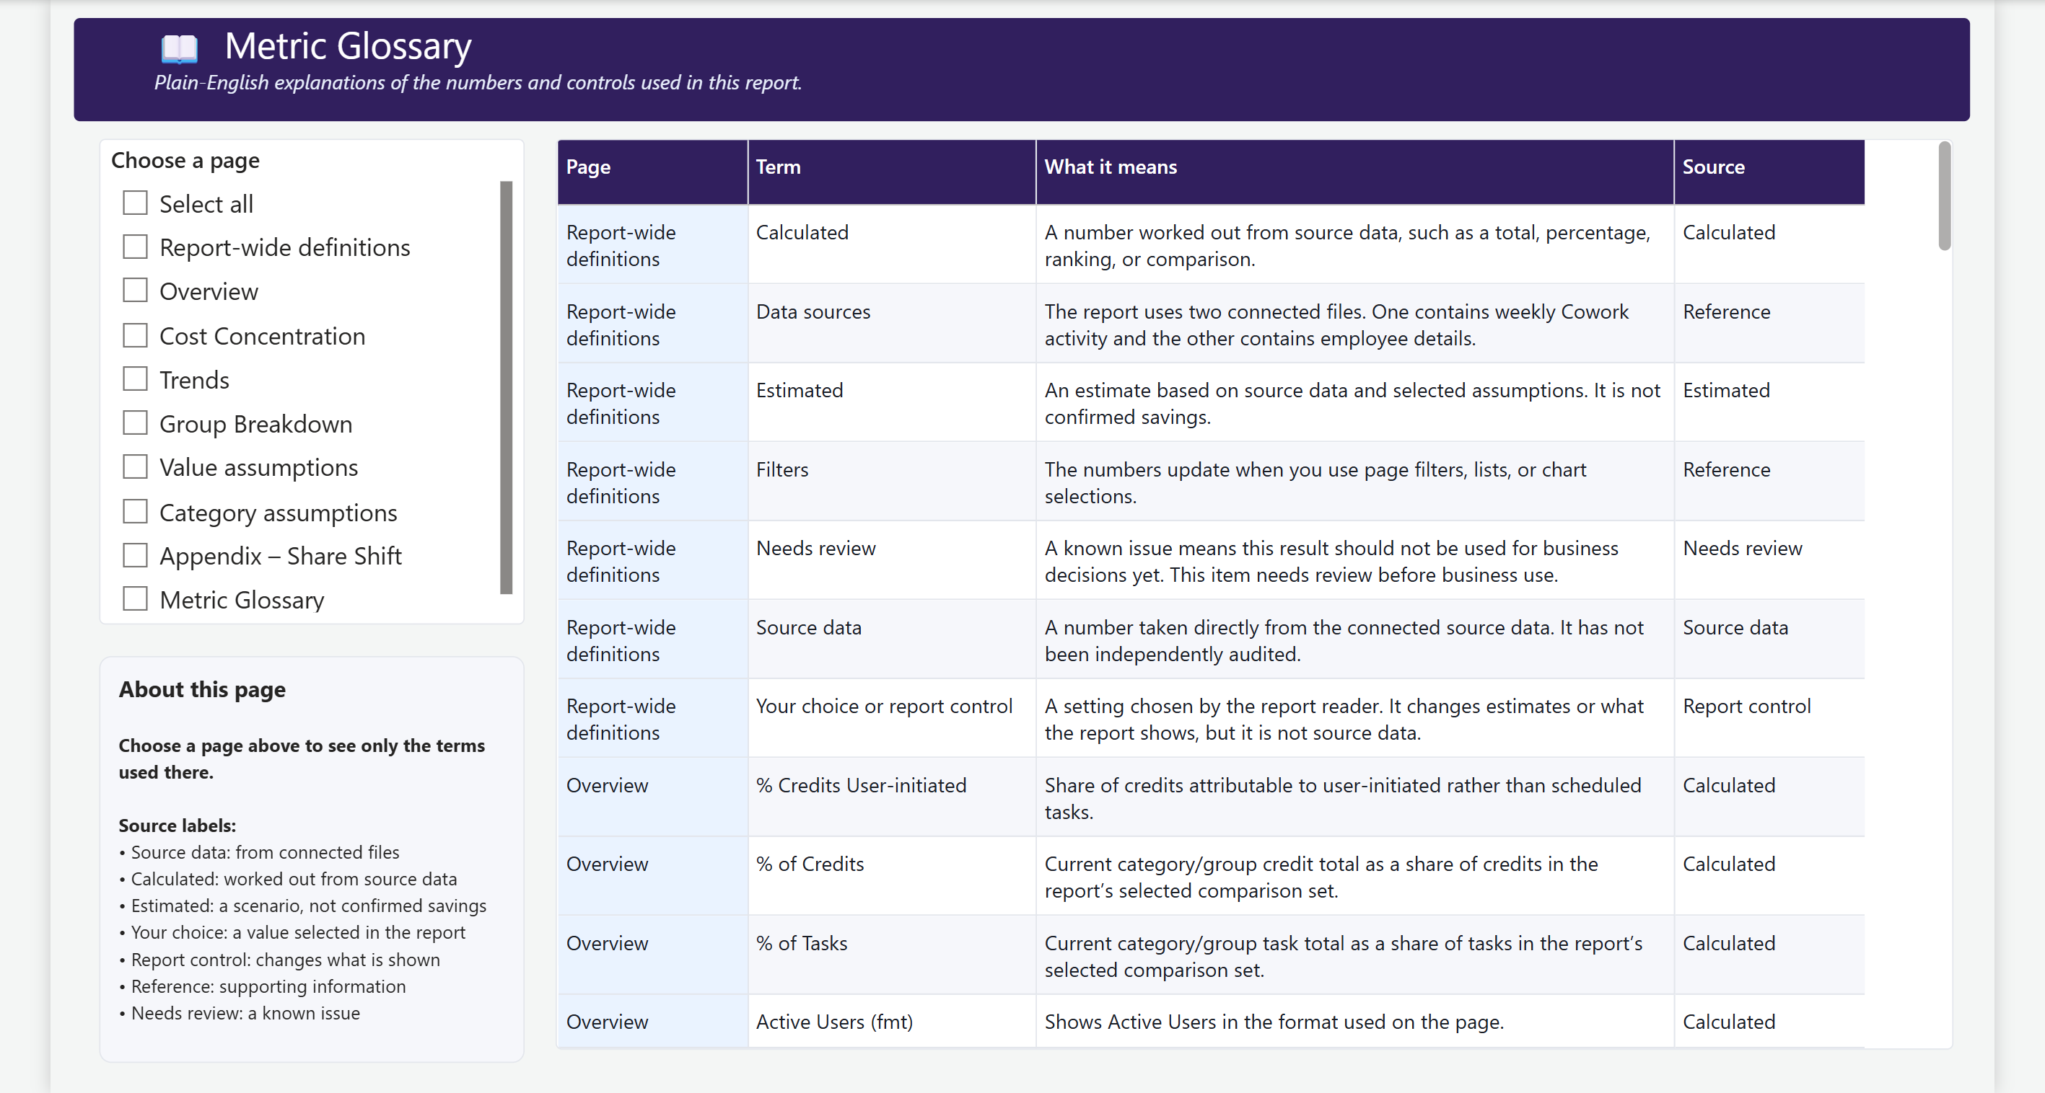
8. Metric Glossary
12
Confirm definitions, lineage, controls, and known limitations.
KEY BUSINESS QUESTION
Does everyone mean the same thing when they quote a metric?
HOW TO READ IT
• Filter by page before reviewing terms.
• Check the Source column: source data, calculated, estimated, control, or needs review.
CONSULTANT ACTION
• Resolve “needs review” items before business decisions.
• Use glossary language in executive readouts and documentation.
WATCH-OUT
A precise definition matters more than a persuasive number.

Slide 13
Interpretation guardrails
13
Use the report confidently without overstating what the data proves.
Observed
Users, tasks, credits, categories, and timing come from the connected source files.
Calculated
Shares, ranks, trends, and comparisons are computed from observed data.
Modeled
Time saved, gross value, net value, and value multiples depend on selected assumptions.
Not inferred
The report does not prove task quality, employee performance, causality, or realized savings.
Consultant standard: state the evidence layer explicitly whenever presenting a conclusion.

Slide 14
Your first 30 days with this report
14
A practical consultant cadence for moving from demo to governed use.
Week 1
Week 2
Week 3
Week 4
Confirm the data
Calibrate assumptions
Diagnose patterns
Commit actions
Validate file schema, date range, user joins, categories, and synthetic-vs-production source status.
Agree time-saved ranges, labor value, realization factor, and attributable credit rate.
Review concentration, growth drivers, cohort shifts, and department outliers with owners.
Select enablement experiments, governance checks, owners, success metrics, and review dates.
Deliverable
Deliverable
Deliverable
Deliverable
Data-quality sign-off
Assumption register
Insight and risk log
30/60/90-day action plan

Slide 15
The consultant’s closing question
What decision will change because of this insight?
If the answer is unclear, return to the evidence layer, challenge the assumptions, and narrow the recommendation.
Observe → Interpret → Challenge → Act
Cowork Super User V1 · Interpretation Guide · Synthetic demonstration data

